Slide 1
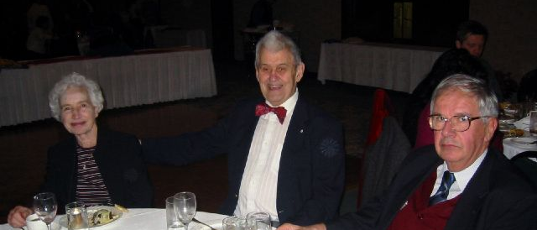
TARA VAGR
26 Nov 2020

Slide 2
VAGR
Welcome every one
Adoption of agenda
Nomination of a recording secretary
TRIUMF presentations

Slide 3
AGENDA
We will follow this agenda:
14:10 – 14:30 Zoom session connection, debugging and help, self intro
14:30 - 15:30 Meeting presentations
- Status of TRIUMF, updates on ARIEL
- Long term options considered for TRIUMF’s 20 years vision:
- Contributions from TRIUMF to Canada’s challenges related to the COVID-19 pandemic
By Associate director Reiner Kruecken (30min)
- Status of IAMI ( Institute for Advanced Medical Isotopes): Esther Schirmacher (20min)
- Flash therapy research at ARIEL : Connie Hoehr ( 10min)
- Leadership change and search for the next director: Ian Doyle (10 min)
15:40 – 16:30 TARA business:
- Pacific Blue Cross report: Lucy Sousa ( Dehoney et al) 10 min
- Approval on last year’s AGM minutes
- TARA chair report, membership report
- Election of the new Executive
-AOB

Slide 4
2020 Executive committee
2020 Executive members
Nicole Bienvenu ( 2019 AGR recording secretary)
Mike Brigham
Andy Hurst
Fred Jones
Corrie Kost ( web master)
Roy Moore (Membership)
Dana Giasson ( administrative assistant to TARA)
Jim Hanlon (Management liaison)
JM Poutissou (Chair)

Slide 5
Proposed agenda
15:30 – 16:00 TARA business:
- Pacific Blue Cross news Lucy Sousa ( Dehoney financial) 10 min)
- Approval off last year’s AGM minutes
- TARA chair report, membership report
- Election of the new Executive
AOB
Virtual party and drinks

Slide 6
Approval of last year AGR minutes
Corrections
Votes

Slide 7
Chair
4 exec meetings two live in Nov & Jan then 2 virtual ones in Sept and Nov.
Activities related to terms of reference for TARA and history of TRIUMF were envisaged back in Jan but curtailed throughout the year.
Attempt to organize a Life celebration ceremony for Gerardo Dutto initiated but failed due to lockdown in March
Attempt for a Dutto celebration during science week also cancelled.

Slide 8
2020 VAGR Business
Nomination of Executive members for 2021
Previous members accept continuing to serve
New nominations
Tamara Hurtado
Franco Mammarella
Others from the… screen????
Voting

Slide 9
AOB
Recommendations for Pacific Blue Cross coverage update
“Retiree” Gordon Ball awarded the CAP-Vogt medal by the Canadian Association Physicists
Send off for the director J.Bagger
Contact Jana Thomson (Thomson@triumf.ca)
Motion to adjourn business part of the VAGR
Show of hands
Don’t forget to wash your hands

Slide 10
Virtual party
Start of the virtual, confined , calm, kind and safe party
Don’t forget to wash your hands

Slide 11
Virtual drinks
ONLY with your own tiny bubbleS() of choice
Enjoy
Bye

