Slide 1
Hybrid Vehicles
Different Types:
Mild Hybrid
Full Hybrid
Plug-in hybrid
(newest) Electric vehicles with Range extender

Slide 2
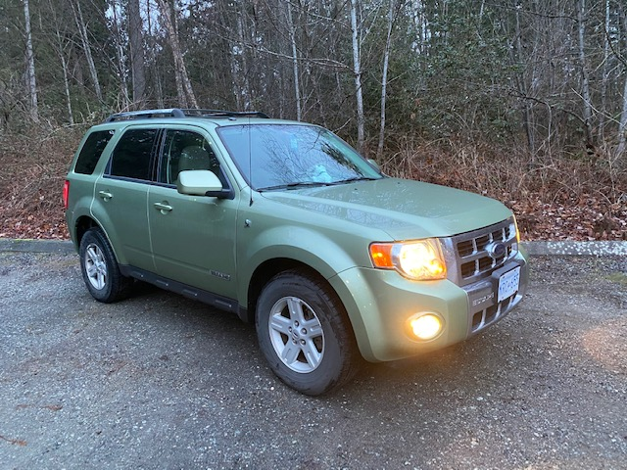
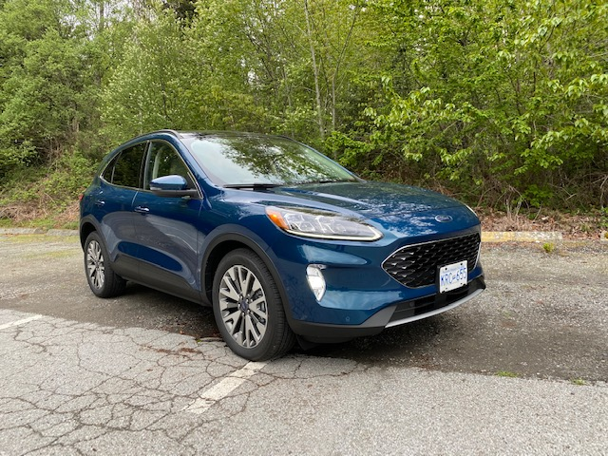
Improvements in Hybrid Technology
Less expensive batteries
Batteries have longer life
UltraBattery uses supercapacitors
Smaller and lighter weight = better milage

Slide 3
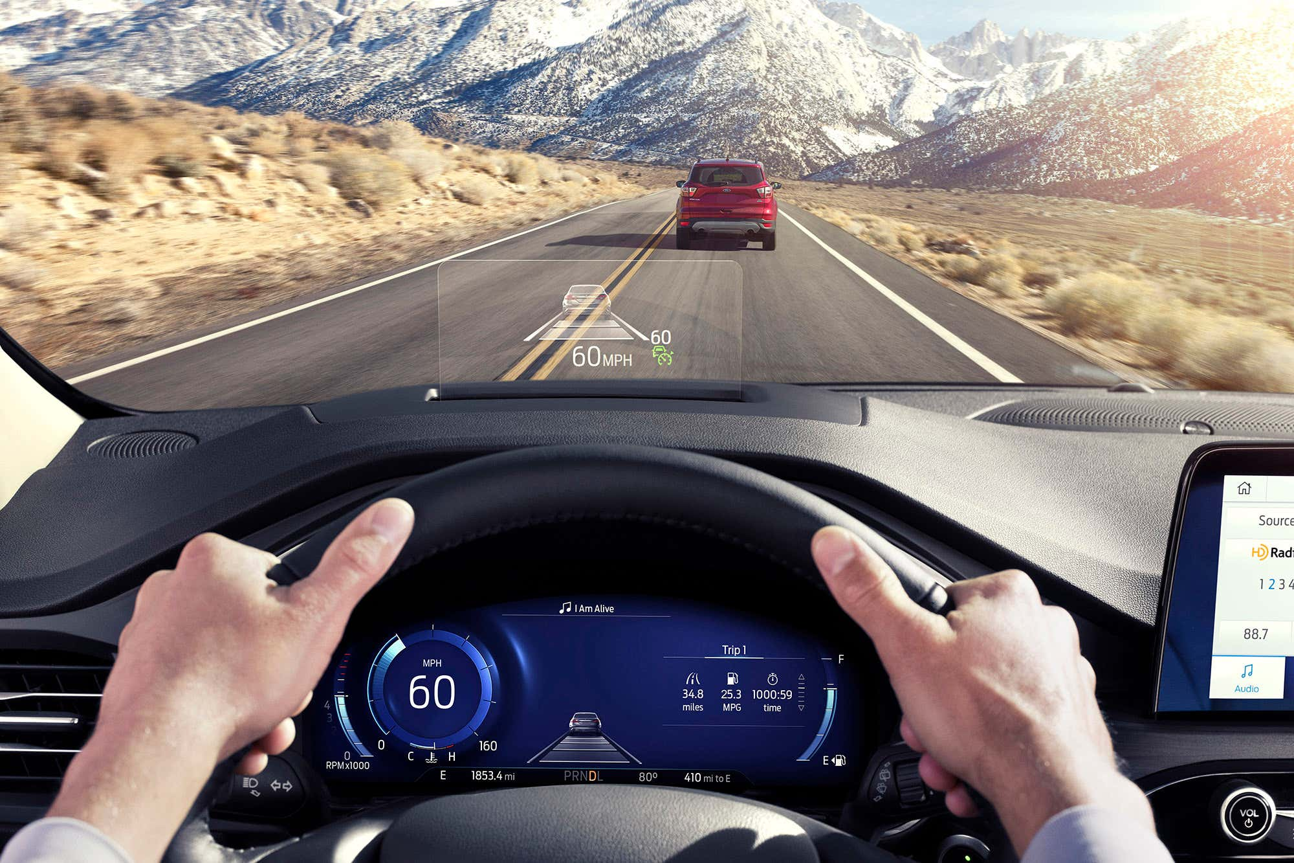
Technology & Features
Ford Co-pilot 360
Titanium Version
AWD

